Slide 1
Why do you need version control?
By Shahbaz Chaudhary

Slide 2
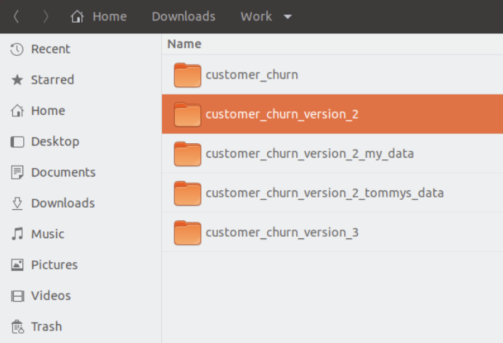
1. Version control remembers history
Version control remembers every change you make to your project.
You can make comments about the reason you changed something.
You can go back in time to any change.
You can even have multiple timelines – people working on different versions of code.
All in a single directory

Slide 3
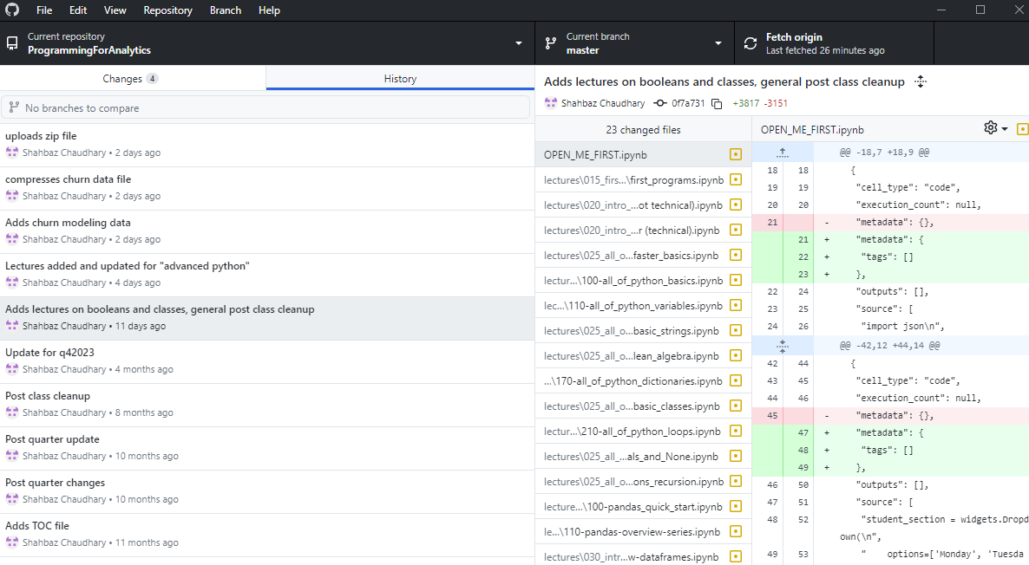
1. Version control remembers history

Slide 4
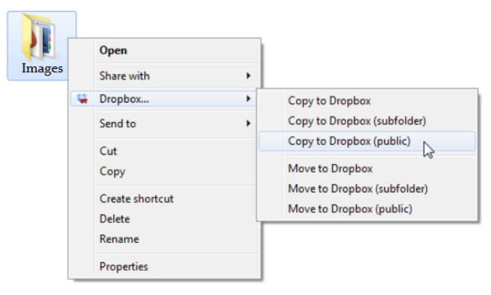
2. A remote repository can serve as a backup
You can replicate the full history of your version-controlled repository to a remote server. Your collaborators can pull this repository, along with its full history.

Slide 5
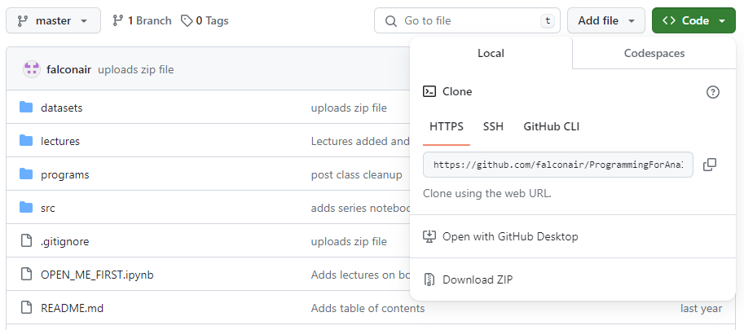
2. A remote repository can serve as a backup

Slide 6
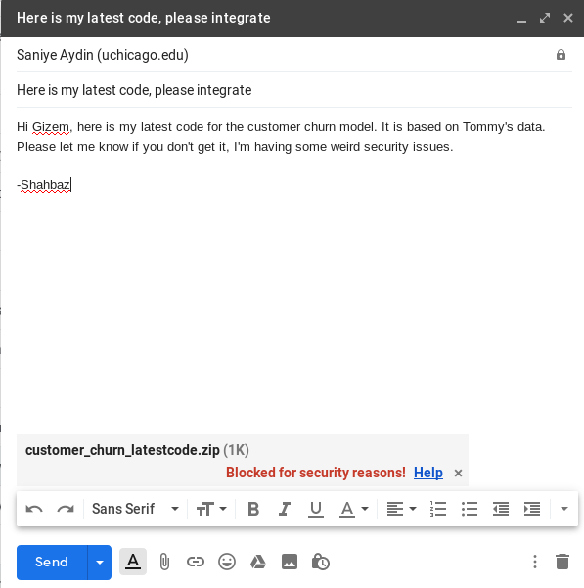
3. A web-based service can make collaboration easier
Modern repository services, such as GitHub and BitBucket make it very easy to collaborate.
Linus Torvalds actually created git for internet scale collaboration for the Linux kernel (story time).
These services further provide space for task management and other services

Slide 7
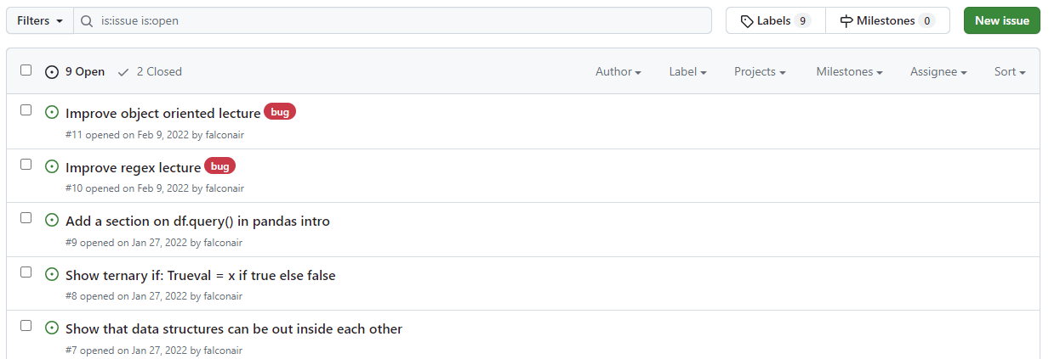
3. A web-based service can make collaboration easier

Slide 8
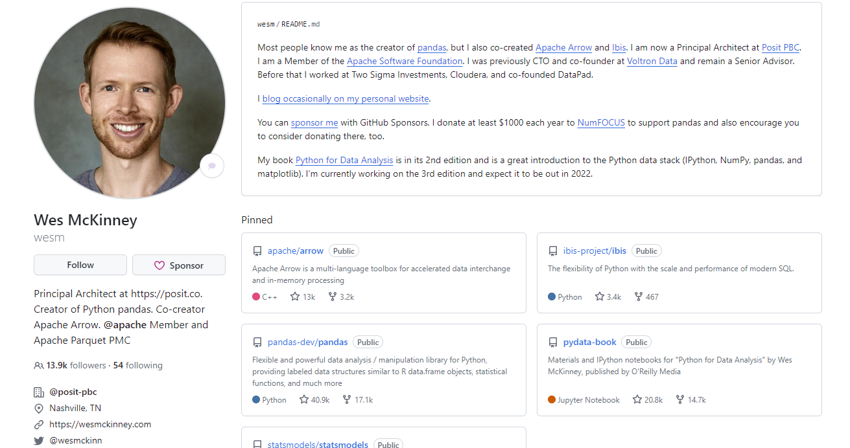
4. GitHub is also the modern resume (along with Linked-In)
Employers often ask for a public GitHub link to see actual code examples.
Use it to showcase class projects, side-gigs, even little blurbs about yourself.
But DON’T misrepresent your work! I have personally found examples of copied code!

Slide 9
Benefits of version control
Record history
Provides a backup
Make collaboration easier
It is your resume

Slide 10
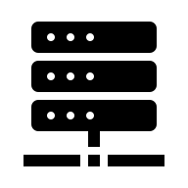



Git: an overview (simplified)
Git is most often used as a hub-and-spoke system. The server is the “source of truth.” The server may be GitHub, BitBucket, your company’s local installation or some other vendor.
You and your colleagues develop code on your laptops
The code is pushed to and pulled from the central server
The code is often also deployed via git.
Just like your laptop, the repository can be cloned on the server. Periodically, a git pull can be performed on the server to keep the code in sync.

Slide 11

Git: an overview (more realistic)
Git’s architecture is actually a bit more interesting!
Git belongs to a category of version control systems known as “decentralized and distributed” version control.
When you clone a repo, your laptop actually has the full history, not just a snapshot. If the central server goes away, you don’t lose anything!
In reality, a Git system is not “clients connecting to a server.” It is closer to “independent git repositories connecting to other git repositories”

Slide 12
Git: common workflow
Clone repository: git clone http://…/your_repo
Keep it up to date: git pull …
Make your edits, then tell your local git to track them: git add …
When ready, record those changes to your local git: git commit –m “this change does this or that”
Send your changes to the server: git push

Slide 13
Hands on keyboard …

Slide 14
Install Git https://git-scm.com/downloads
Some nice GUIs cataloged at: https://git-scm.com/downloads/guis
GitHub has a very minimal GUI (seen earlier): https://desktop.github.com/
Jupyter Lab has a well integrated Git extension: https://github.com/jupyterlab/jupyterlab-git
VS Code has a built-in Git extension

Slide 15
git clone
“Download” a remote repository

Slide 16
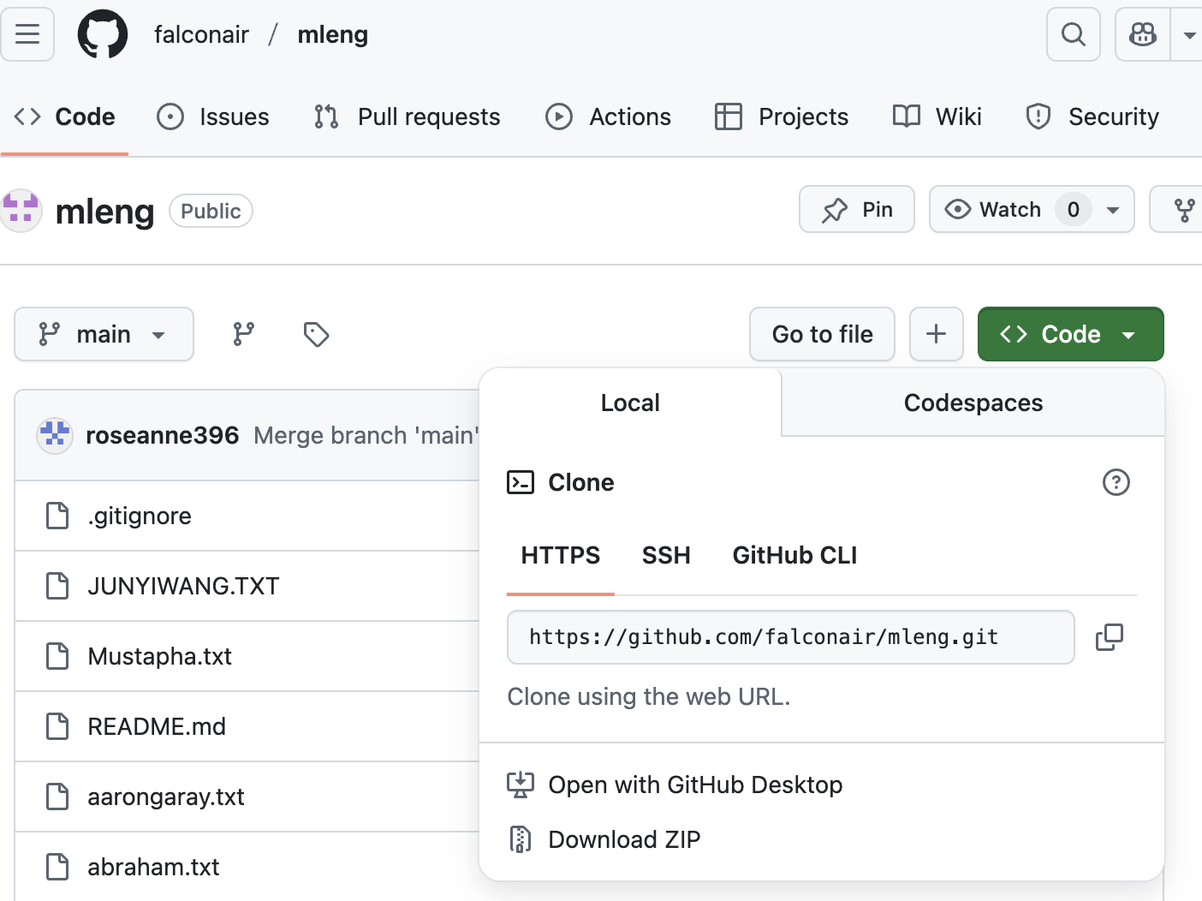
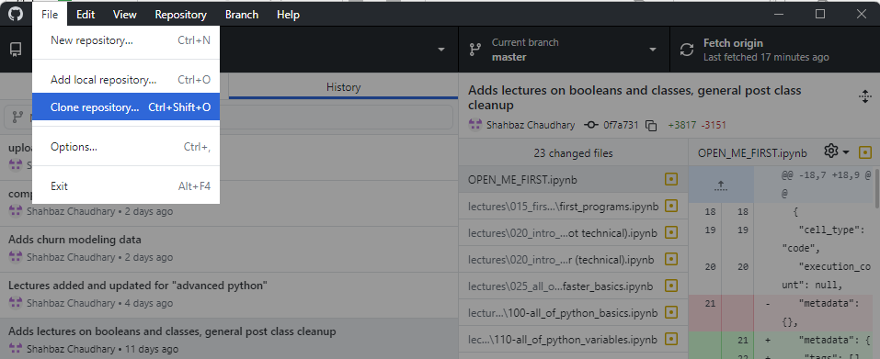
Clone a repository https://github.com/falconair/mleng_class
Click “Clone”
Using GitHub Desktop
Using the command line
git clone https://github.com/falconair/mleng_class.git

Slide 17
Create a new repo

Slide 18
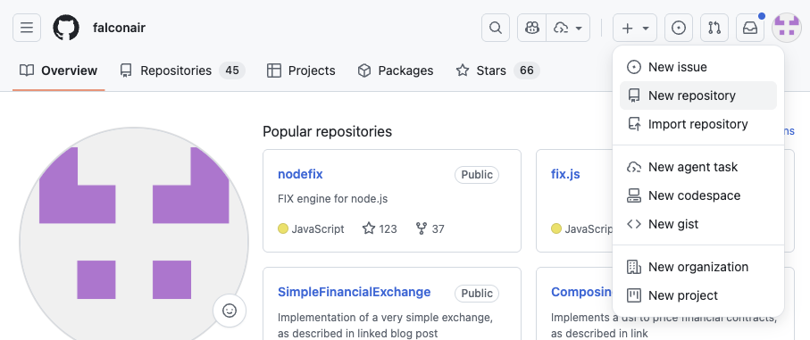
Create a new repo

Slide 19
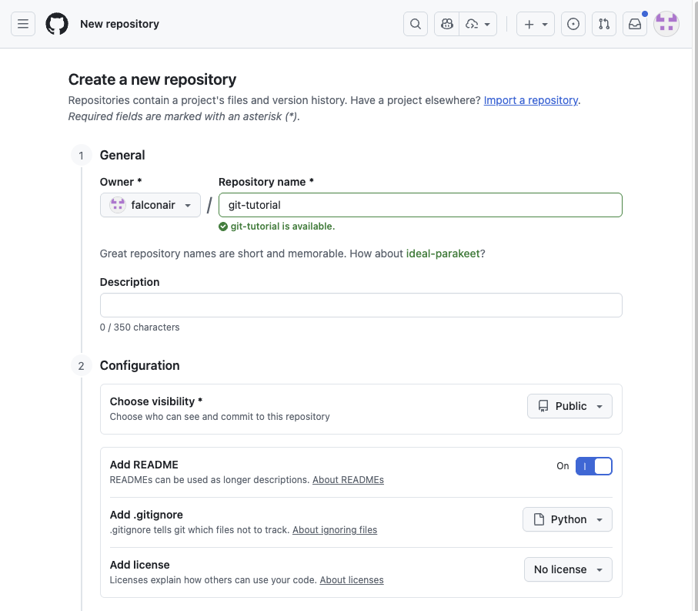
Create a new repo Give it a name
Do add a README, it describes your repository (but not necessary)
If you don’t want something on the public web, then make your repo private!
Good practice to add a .gitignore. It lets you keep certain files out of git (such as passwords)
You can skip this

Slide 20
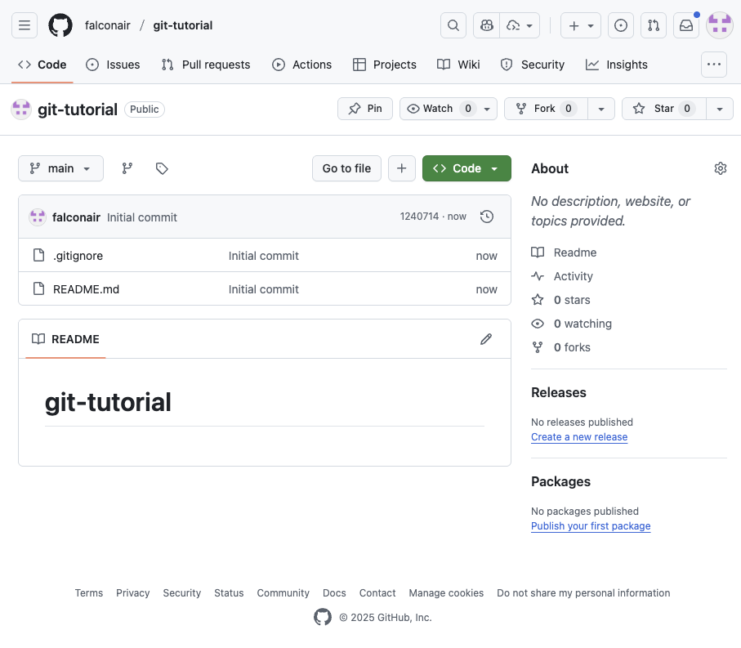
Create a new repo You now have a new repo!
You can ”clone” this repo, or download it to your computer
The text you see here comes from the README.md file

Slide 21
Clone a repository https://github.com/YOUR_USER_NAME/git_tutorial
Click “Clone”
Using GitHub Desktop
Using the command line
git clone https://github.com/YOUR_USER_NAME/git-tutorial.git

Slide 22
Clone a repository vs downloading it
Download a repo | Clone a repo
The downloaded object and the remote object are two separate entities, with no binding connection | The downloaded repository is connected to the remote repo. Git can tell when the two are out of sync and can sync them.
 | Git remembers the history of changes on your laptop, as well as the remote server. Git remembers the change, who made it, when it was made.
 | You can even ask Git to show you the differences between files of various versions

Slide 23
git pull
Bring changes from remote server to your machine

Slide 24
Get latest changes with git pull
Me
git clone
git push
git push
Git Server
New repo
git clone
git pull
git pull
You
Clone a repo (both)
The one we created earlier
2. Me: Make a change to README.md
3. Me: add that change to Git
a. git add README.md
b. git commit –m “makes a change”
c. git push
4. You: Check the server for change
5. You: Bring that change to your laptop
a. git pull

Slide 25
git add git commit –m “message” git push
Tell git to start tracking a file or a change, make it part of history, send to server

Slide 26
Record your change with git add -> git commit -> git push
Me
git pull
git pull
Git Server
git push
git push
You
git add
git commit – “New file …”
git add
git commit – “Removes typo from …”
New file
Update file
Tip:
Use git status to check the status
Use git diff to compare uncommitted changes

Slide 27
That’s it for basic Git usage: clone, push, pull!
Now let’s look at a couple of intermediate features

Slide 28
git branch git checkout –b branch_name
Create a branch to isolate work

Slide 29
Compartmentalize your work
Git Server
git push
main
git branch feature123
git switch feature123
New file
git switch feature123
git merge feature123
git add
git commit ..
git switch main
git switch main
feature123
Get changes from remote server |  | git pull
Tell git to start tracking this file |  | git add
Tell git to record the change |  | git commit –m “message”
List all branches |  | git branch
Switch to a different branch |  | git switch branch_name
… create it if it doesn’t exist |  | git switch –c branch_name
Bring changes into the current branch |  | git merge branch_name

Slide 30
Compartmentalize your work
Git Server
git push
main
git branch feature123
git switch feature123
New file
git switch feature123
git merge feature123
git add
git commit ..
git switch main
git checkout main
feature123
1. Create new branch feature1
2. Switch to it
3. Switch back to main
4. Switch to feature1
5. Create new file
It exists in both branches since it
isn’t tracked by git
6. Add and commit
It only exists in feature1
List all branches |  | git branch
Switch to a different branch |  | git switch branch_name
… create it if it doesn’t exist |  | git switch –c branch_name
Bring changes into the current branch |  | git merge branch_name

Slide 31
git merge
What if conflicting changes are made to the same file?

Slide 32

What if changes conflict?
test
main
git add
git commit ..
main
git branch conflict
git switch conflict
New file
test.txt
git merge conflict
New file
test.txt
Same file, conflicting edits!
feature123
git switch main
git add
git commit ..
1. Create new branch conflict
2. Switch to it
3. Create file test.txt with “test”
4. Add and commit
5. Switch back to main
6. Create file test.txt with “main”
7. Add and commit
8. git merge conflict
9. Use git diff to see the difference
10. Need to resolve the conflict!
List all branches |  | git branch
Switch to a different branch |  | git switch branch_name
… create it if it doesn’t exist |  | git switch –c branch_name
Bring changes into the current branch |  | git merge branch_name

Slide 33

…or just overwrite the local file

Slide 34
git add?
Actually, there is another layer, called stage

Slide 35
Introducing the “stage” layer
Git Server
main
stage
Create new file
or make a change
git add file
Make more edits
git add file
git commit –m “adds two files”
git push

Slide 36
Git’s pull is actually fetch + merge
Git Server
stage
main
git pull
git fetch
git fetch
git merge
Make more edits

Slide 37
Appendix

Slide 38
git branch
Keep clean development histories

Slide 39
The story so far: git clone|pull|diff
Download repository to your laptop: git clone
Get latest changes: git pull
Merge conflicts happen when there are conflicting changes in a file. The git diff command can give more details, but most of us should switch to GUI tools to resolve conflicts.
Resolving a merge conflict, although scary sounding, just means that a human needs to decide which changes to keep.

Slide 40

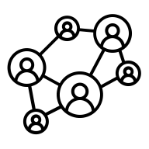

Git is a distributed version control system
When you clone a repository, you are pulling down all the files and their history.
You then operate only on the local copy. If you want to sync the changes, you have to explicitly push the changes back.
Git operates as a giant network of peers, not as a remote/local hierarchy

Slide 41
Recap: clone, pull, diff, commit, push
git clone <repo>
Downloads the repo to laptop

Slide 42
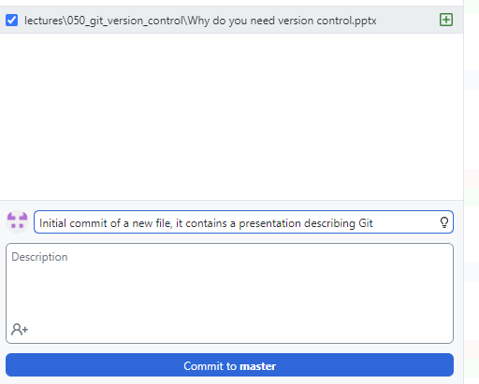
Create a repo, git commit and git push to it
So far, we have had only one way interactions with repositories. Now we need to go the other way.
Create an account on GitHub (pick your name wisely, it will be your internet identity)
Create a new repository
Clone it
Add a new file to it
How has the status changed?
1. “Commit” file to version control
2. “Push” file to remote repository

Slide 43
For a future episode…

Slide 44
More commands
git commit –m “fixed bug #123”
git push
git reset
git branch
git …

Slide 45
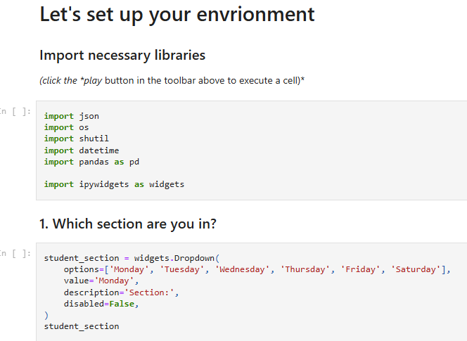
Reminder: Jupyter notebooks are just JSON
{
"cells": [
{
"cell_type": "markdown",
"metadata": {},
"source": [
"# Let's set up your envrionment"
]
},
{
"cell_type": "markdown",
"metadata": {},
"source": [
"### Import necessary libraries \n",
"*(click the *play* button in the toolbar above to execute a cell)*"
]
},

